Slide 1
ML PROJECT
Loan Default Prediction
# Nod 2025
Jonathan Avigdor

Slide 2
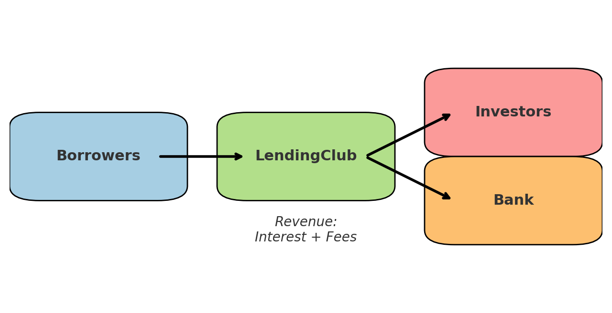
Intro - Lending Club
LendingClub
U.S. fintech, founded 2006
Provides personal loans
Works as a digital bank & marketplace
Business model
Borrowers take loans
Bank or investors fund them
Revenue = interest + fees

Slide 3
Data Set
The dataset covers 2007–2020, with 2.2M loans and 151 features.
It includes:
Borrower information: employment length, credit history length, annual income, loan grade
Loan terms: loan period, loan amount, interest rate, monthly installment
Outcomes: loan status (Fully Paid / Default), total payment, recoveries, last payment date, outstanding balance

Slide 4
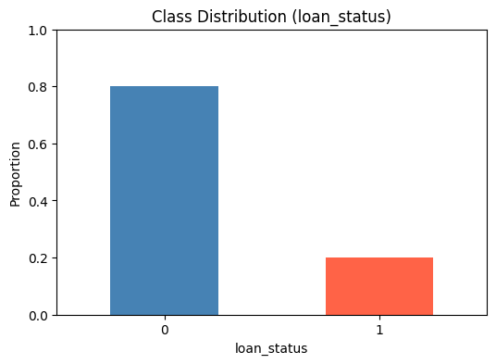
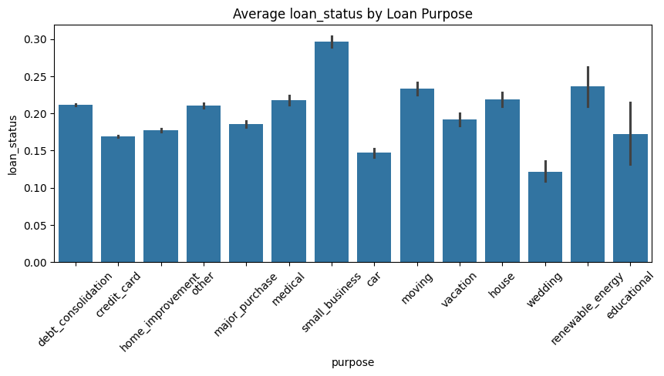
EDA

Slide 5
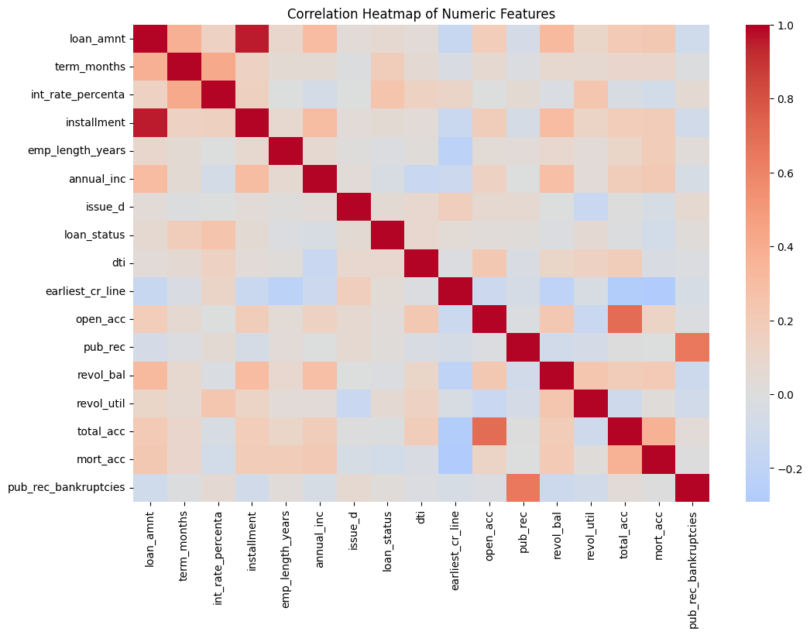
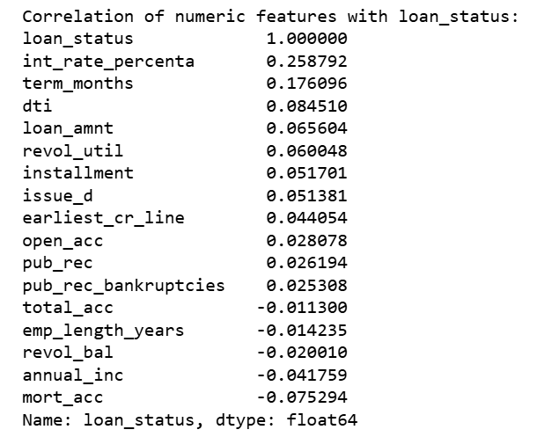
EDA - Numeric Feature Correlation

Slide 6
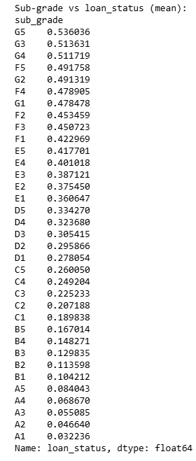
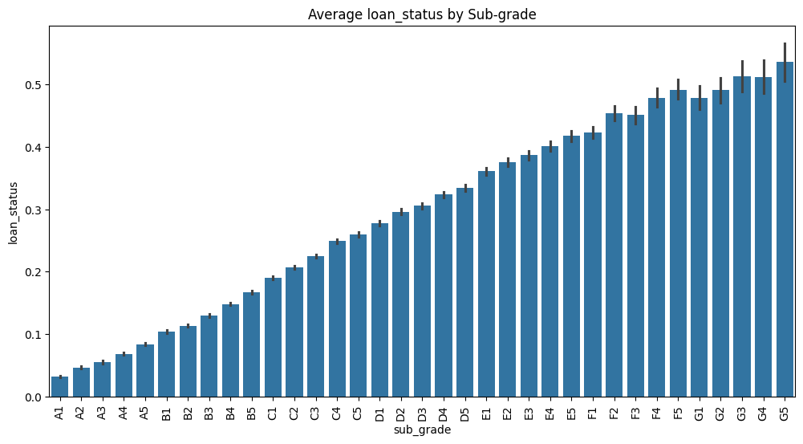
EDA

Slide 7
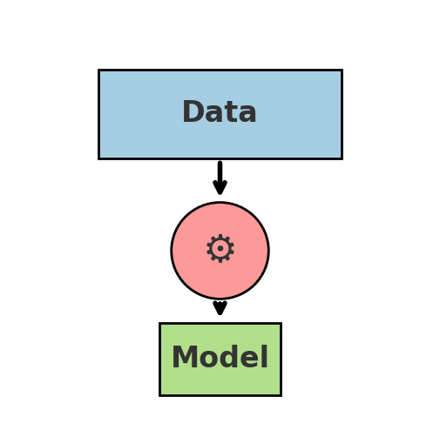
Data Cleaning and Preprocessing
Drop columns with >40% missing values
Remove rows with missing values
Remove unnecessary columns (IDs, URLs)
Drop leakage features (e.g., payments after issuance)
Handle outliers (cap at 1%–99%)
Encode categorical features (dummies)
Define target column → loan_status
Scale numeric features (for Logistic Regression)
Split into train & test sets
Build pipelines → automate preprocessing + model training
Train models on training set
Predict & evaluate on test set

Slide 8
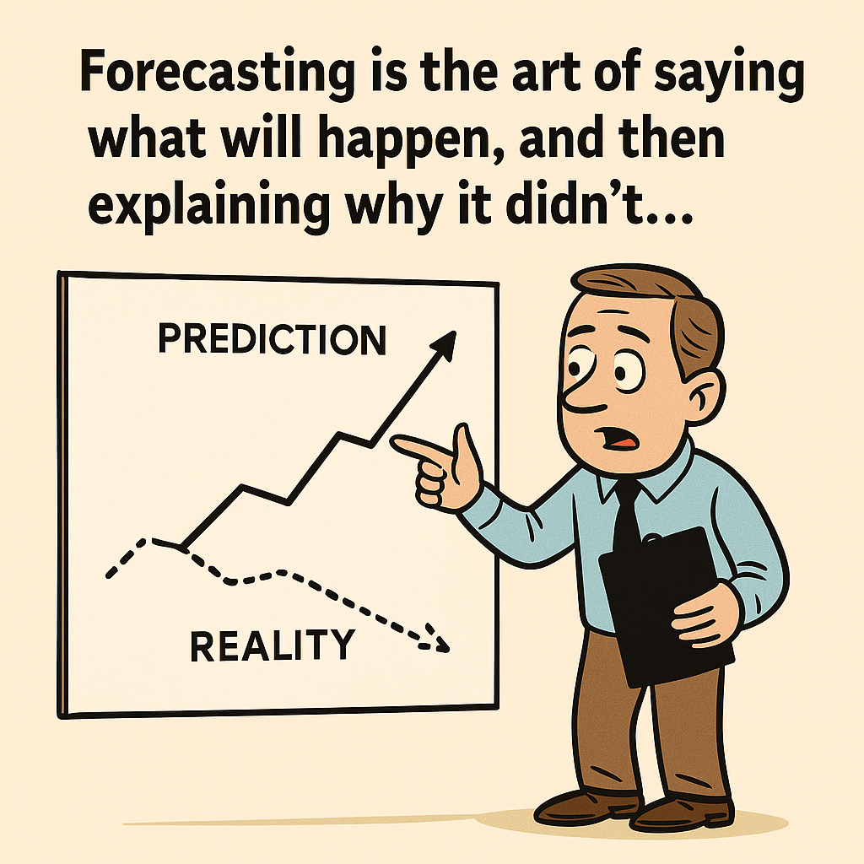

Slide 9
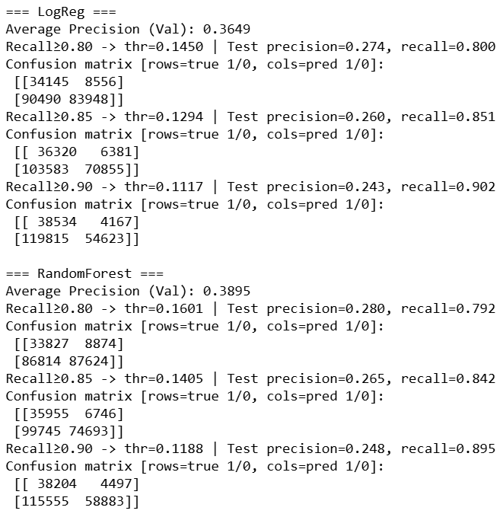
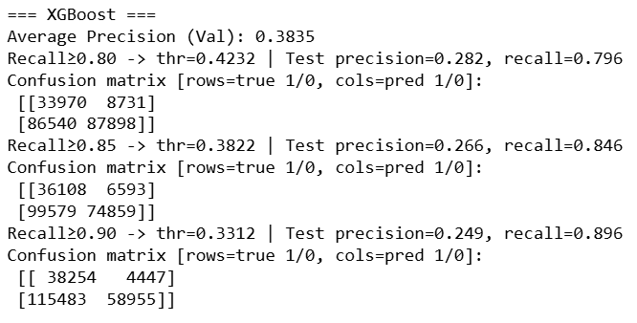
First Run Results

Slide 10


Feature Engineering
Merge low loan purpose - other
New column - sub_grade_X_loan_amount
New column - Installment_to_income column
New column - emp_length_sq

Slide 11
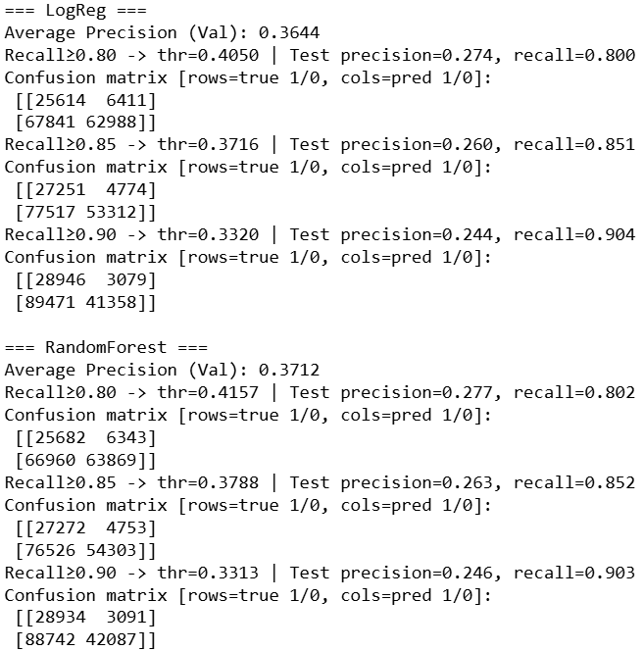
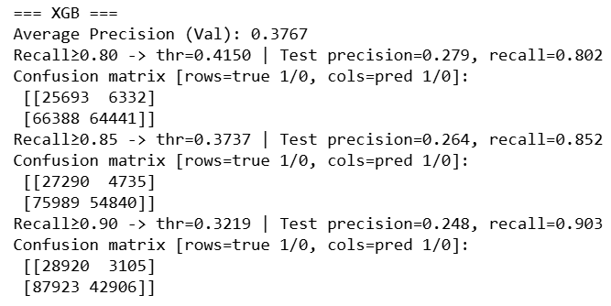
Secund Run Results

Slide 12
Data Reinspection
Feature engineering didn’t improve results → revisited raw data to check if important columns were dropped during cleaning. Ensured no useful signals were lost.

Slide 13
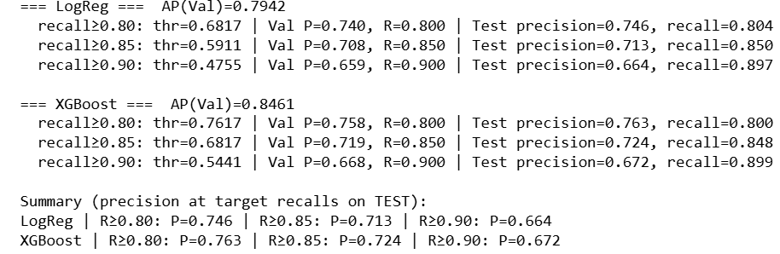
Third Run Results
BAM!!!!!!!!!

Slide 14
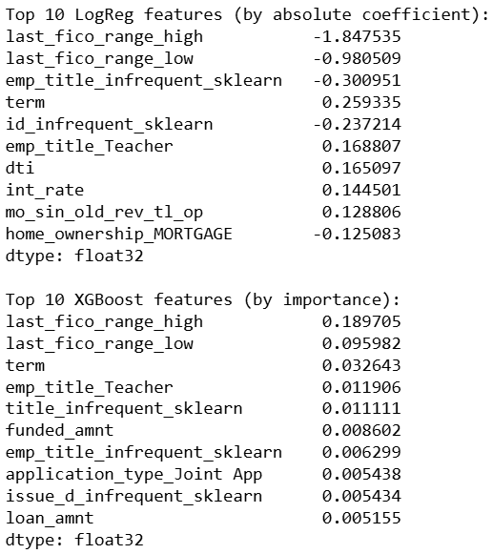
🚨 Leakage Alert !
last_fico_range_high and last_fico_range_low are leakage features because they’re updated after the loan is issued, revealing future borrower performance. Using them gives the model unrealistically good results that wouldn’t work in real life.
NOT A BAM…

Slide 15
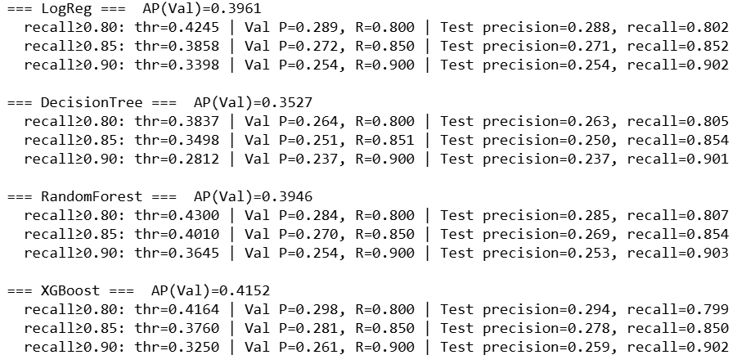
Fourth run results

Slide 16
Conclusion
The final models achieved high recall (>0.9) but at the cost of very low precision (~0.25). This means the models can catch most defaults but also incorrectly classify many good borrowers as risky.
Multiple rounds of feature engineering did not significantly improve performance, showing that the predictive signal in pre-loan data is limited.
The key insight is that loan default is inherently difficult to predict using only pre-origination data (income, employment, etc.). Borrower defaults often depend on future life events such as job loss, medical expenses, economic downturns, or changes in credit behavior—factors that are unknown at the time of application.
As a result, models built only on pre-loan features may face a ceiling in performance: they can identify patterns of higher risk, but they cannot perfectly foresee future borrower behavior.

Slide 17
Thanks for listening!

